Slide 1
K12 Platform - A Comprehensive School Management System
Course, Assignment, and Attendance Management for K-12 Institutions
May 13, 2025

Slide 2
Agenda
#4 Code Walkthrough
File-by-file explanation
#5 Future Work and Conclusion
# 1 Project Overview
Background and purpose
#2 System Architecture
Classes, relationships, and structure
#3 Key Features
Assignments, attendance, events, and more

Slide 3
What is the K12 Platform?
A Java-based console application for school management
Supports students, instructors, and substitutes
Handles courses, assignments, attendance, and school events
Focus on clean OOP architecture and role-specific functionality

Slide 4

Our Goals
Build a functioning educational management system
Implement clean, reusable object-oriented code
Provide different experiences based on user role
Demonstrate a full academic workflow (from course creation to grading)

Slide 5
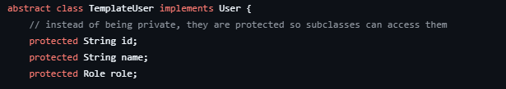
Our Object-Oriented Design
How We Applied Core OOP Concepts:
Abstraction Shared methods and fields (like id, name, and role) are abstracted in the TemplateUser class, which all user roles extend.
Inheritance
Student, Instructor, and SubstituteInstructor all inherit from TemplateUser.
This allows us to reuse code and maintain consistency across users.
Encapsulation
All fields (e.g., absenceCount, submissions) are kept private or protected.
We expose access through public getters and setters to control visibility and protect data.
Polymorphism
Each role overrides the viewDashboard() method.
This allows each user type to have a unique dashboard output using the same method call.

Slide 6
Key Structural Components
Users and Roles
All user types (Student, Instructor, SubstituteInstructor) implement the User interface and extend the shared TemplateUser class.
Roles are enforced using a Role enum.
Courses
Each Course object includes:
An AssignmentManager for handling assignments and submissions.
An AttendanceManager for daily check-ins and absence tracking.
Assignment System
AssignmentManager holds a list of Assignment and AssignmentSubmission objects.
Instructors create assignments; students submit and receive feedback.
Attendance System
Tracks check-in/out time, presence, and parent approval via AttendanceRecord.
Linked to students by name and managed within each course.
Calendar
SchoolCalendar stores a list of Event objects.
Instructors manage events; students and substitutes can view them.

Slide 7



Key Features by User Role
Student | Instructor | Substitute
✔ Submit work | ✔ Grade & feedback | ✔ Take attendance
✔ View calendar | ✔ Create events | ✔ View events
✔ View feedback | ✔ Manage courses | ✘ No grading rights

Slide 8
Code Walkthrough

Slide 9
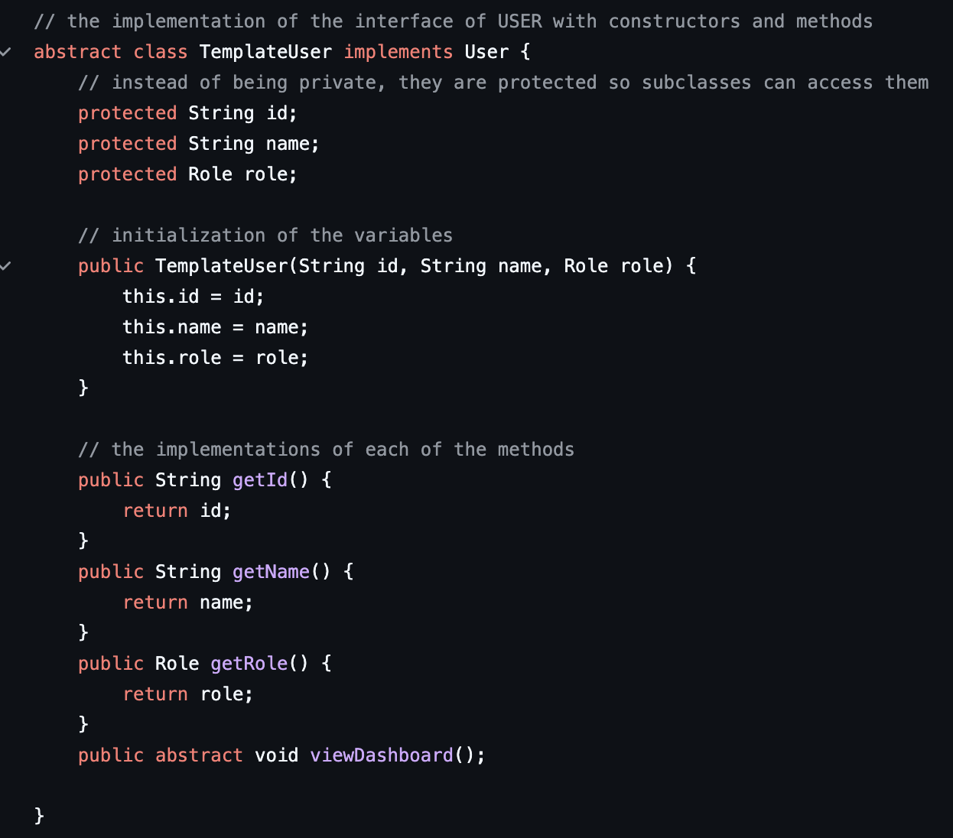
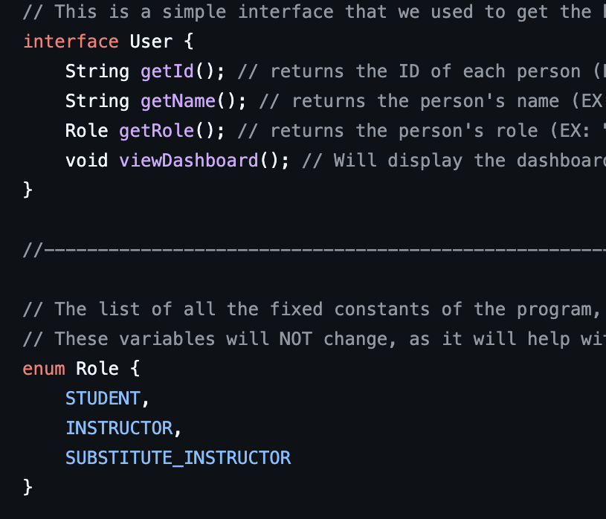
ROLES

Slide 10
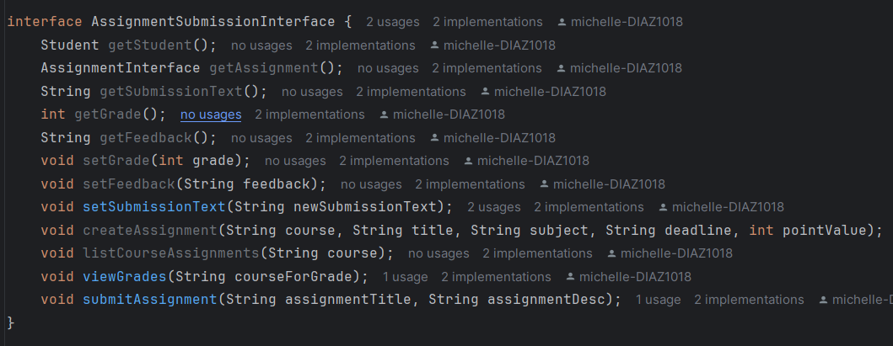
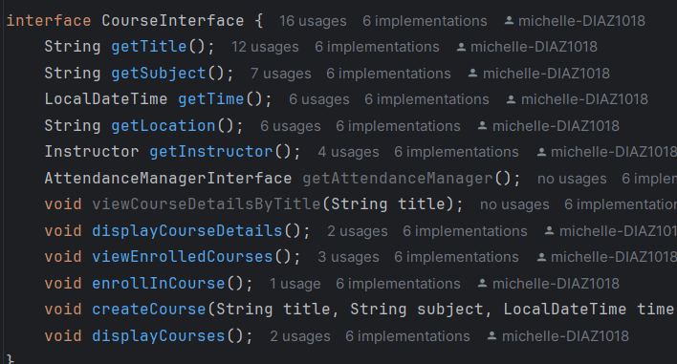
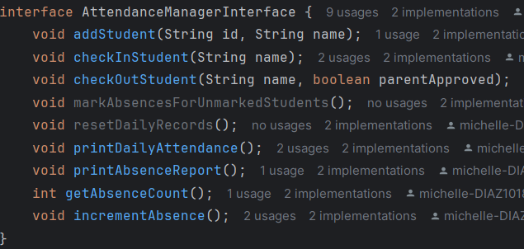
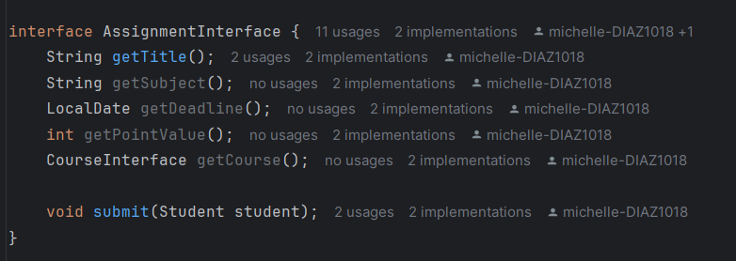
INTERFACES

Slide 11
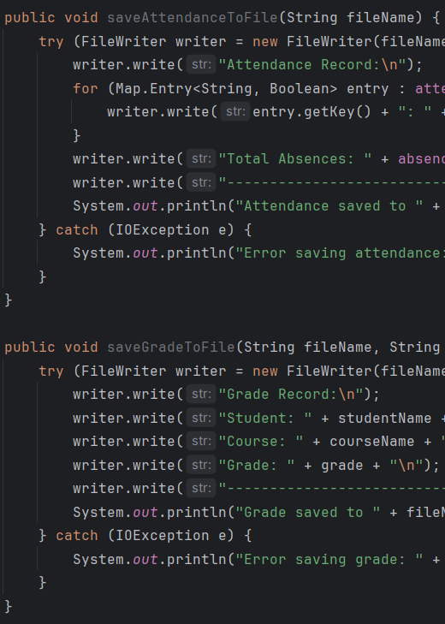
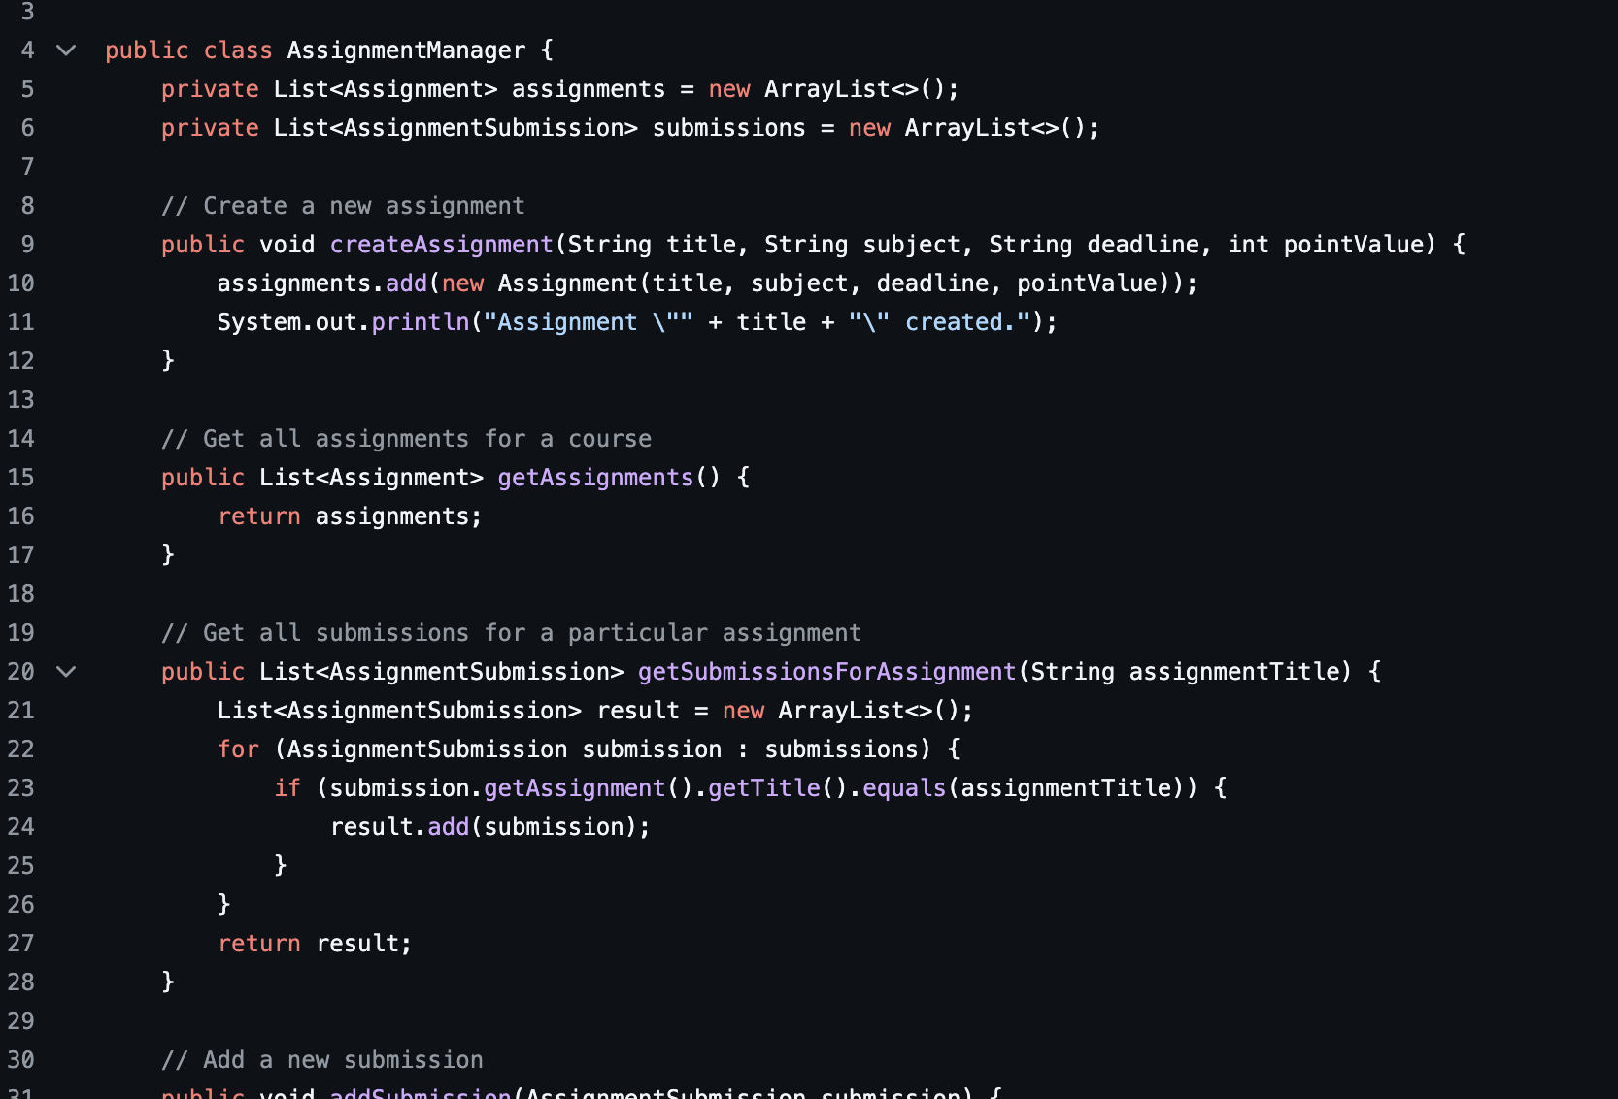
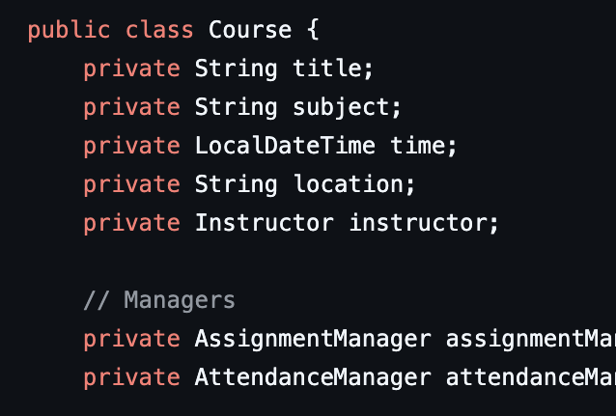
Courses & Assignments

Slide 12
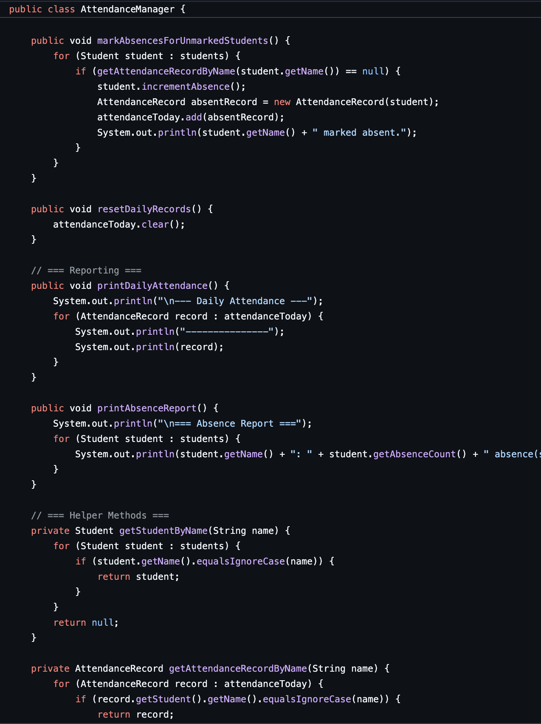
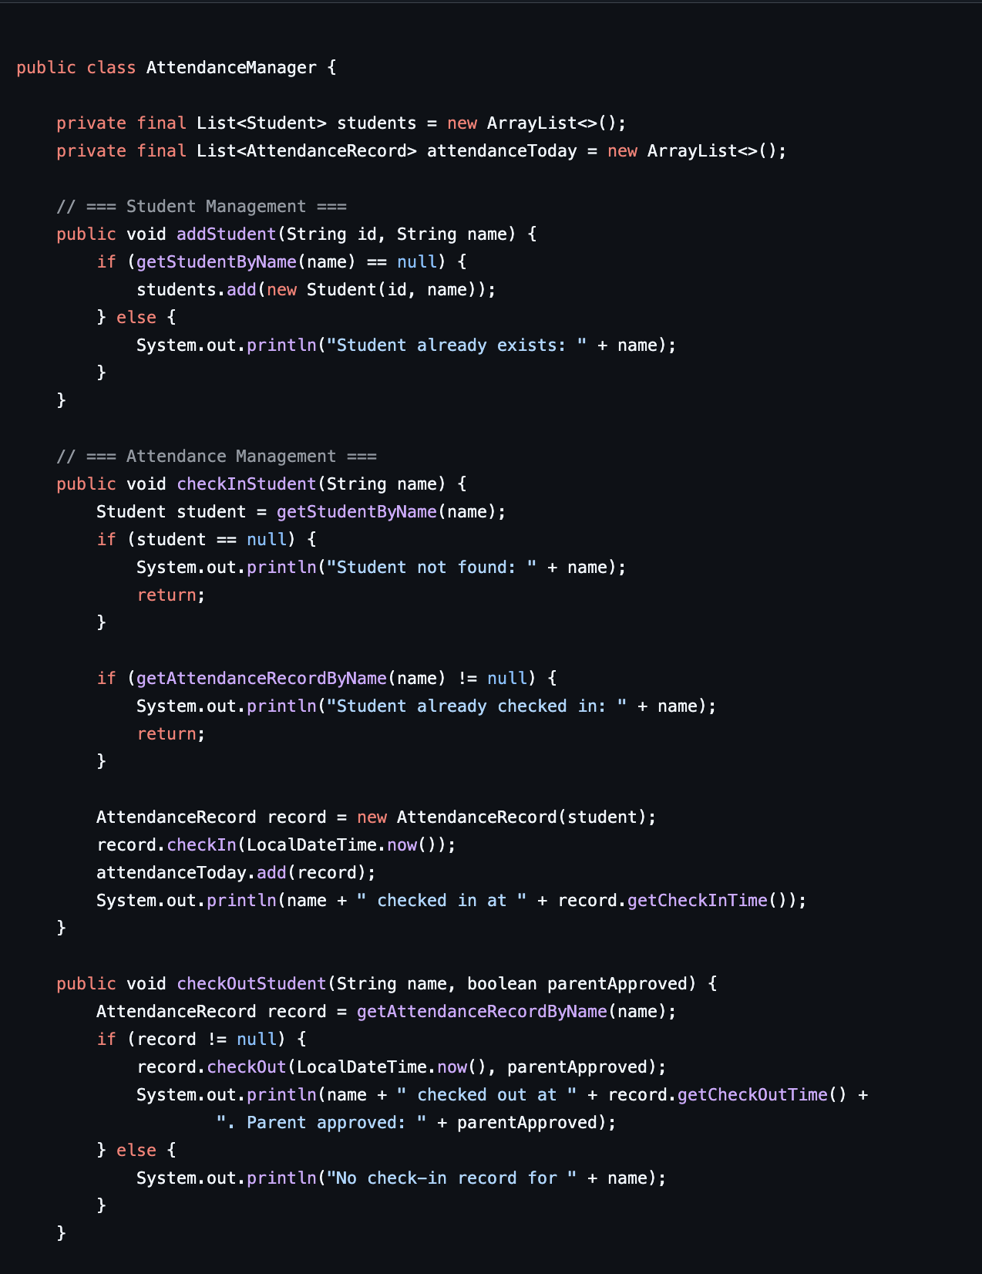
Attendance

Slide 13
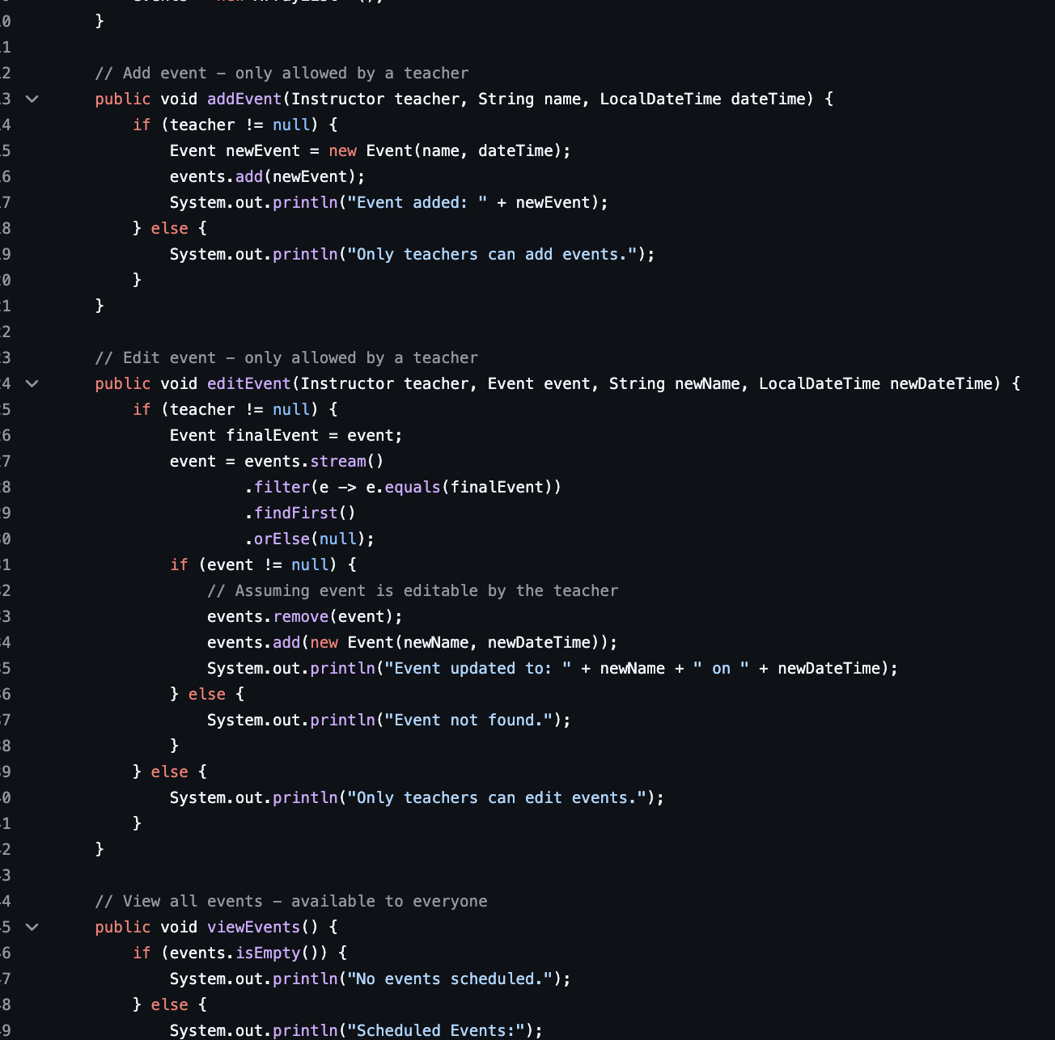
Events

Slide 14

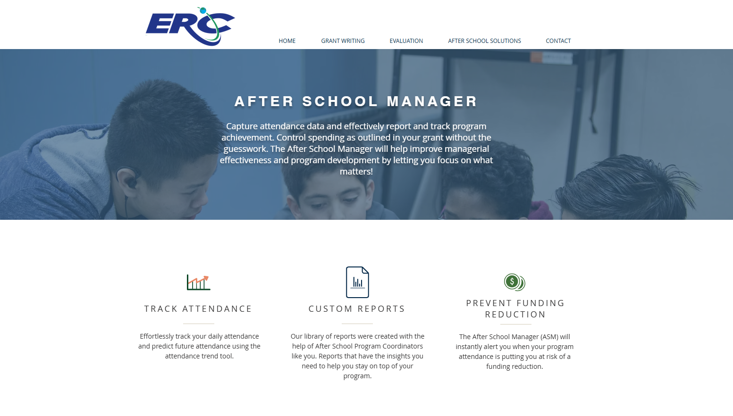
Our Inspiration:

Slide 15
Future Plan!
Implement completed graphical user interface (GUI)
Add database integration for persistent storage
Implement real-time notifications
Add support for file attachments in assignments
Implement a messaging system between users
Add support for online quizzes and exams

